Slide 1
Python Installation and the first program

Slide 2
Learning target
This chapter introduces:
How to install the Python
Create the first program

Slide 3
Installation

Slide 4
Installation
Use the browser to view the webpage on
「 https://www.python.org/downloads/ 」Select the menu
「 Download Python 3.4.3 」

Slide 5
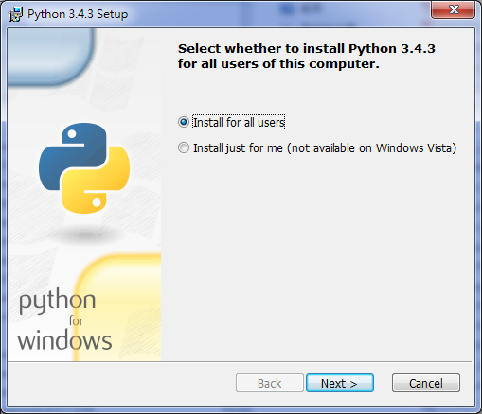
Installation
Click Next

Slide 6
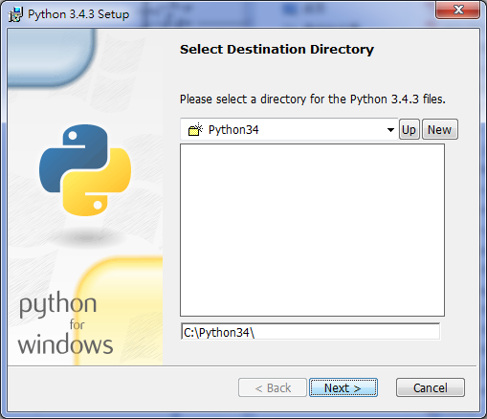
Installation
Click Next

Slide 7
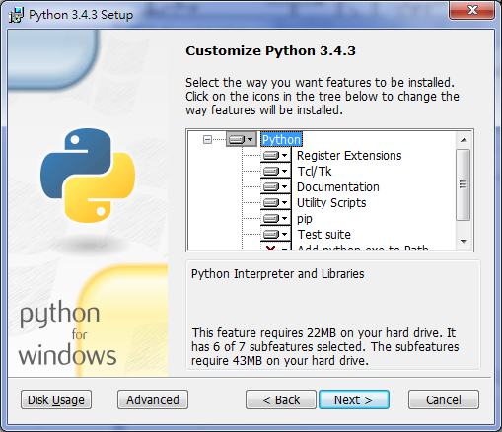
Installation
Click Next

Slide 8
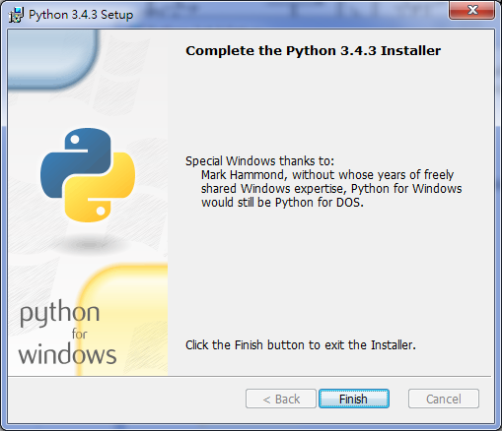
Installation
Click Finish

Slide 9
Installation
Open the search and enter “環境變數” in Chinese Windows System (or "Environment Variable“ in English Windows System)
Edit system environment variables
Click "Environmental Variables (N)",
Select the "Path" item in “System Variables"
Click "Edit (I)...“
Add the locations of the Python installation directory and the Scripts directory into the values of the “Path”
E.g:
C:\Python34;C:\Python34\Scripts

Slide 10
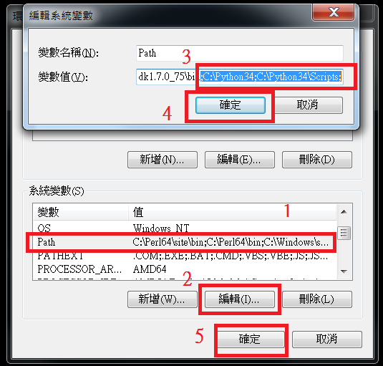
Installation

Slide 11
The first program

Slide 12
The first program
In almost all tutorial language books, his first practice program is HelloWorld
The so-called HelloWorld is to make the program output "HelloWorld“
Here we show how to use Python to write the first Python program

Slide 13
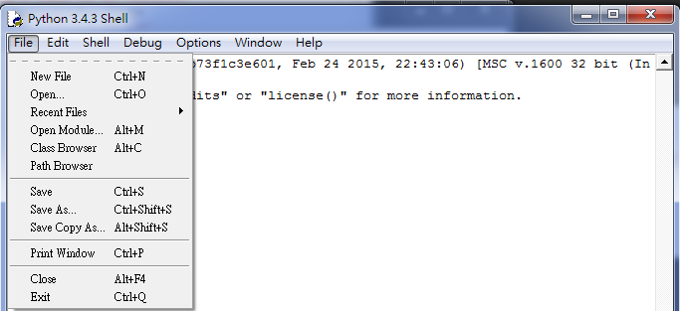
The first program
Turn on IDLE Python 3.4 GUI
New File:Click “File”=>”New File”

Slide 14
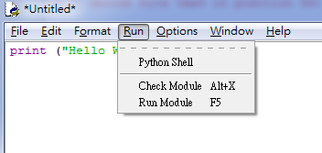
The first program
Enter: print ("Hello World")
Execute: Click “Run”=>”Run Module (F5)”

Slide 15
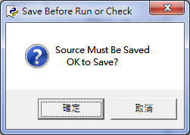
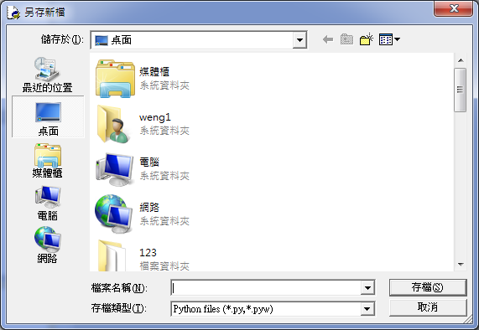
The first program
Click 確定(OK)
Select storage path and enter the file name

Slide 16
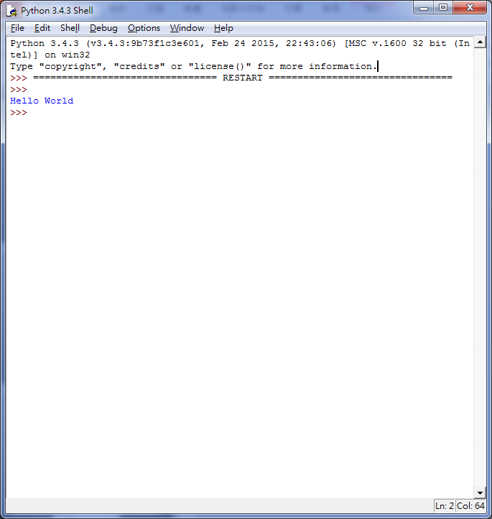
The first program
Result:

Slide 17
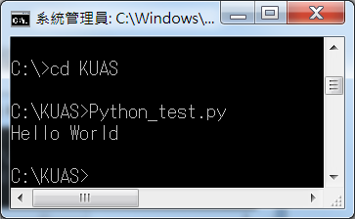
The first program
After saving as a yourname.py file, you can also change your working directory to the specified file storage directory via cmd, and then enter the name of the python file to execute the program to show the result
Result of your python file:

Slide 18
Source
Installation teaching :
http://www.foolegg.com/how-to-build-a-python-programming-environment-on-windows/
http://pydoing.blogspot.tw/2010/11/python-pathset.html
Basic teaching: http://pydoing.blogspot.tw/2014/07/python-guide.html
other information:
http://jishus.org/?p=309

